Slide 1
Short-Term Wind Speed Prediction based on Deep Learning
Submitted By-
Ritwik Vatsa,06220802716,CSE
Vishal Singh Roha,08220802716,CSE

Slide 2
Introduction
Wind speed forecasting has great significance to the improvement of wind turbine intelligent control technology and the stable operation of power system. In this paper, the Long Short-term Memory (LSTM) mode with deep learning ability combined with the fuzzy-rough set theory has been proposed to do short-term wind speed prediction. Fuzzy rough sets can reduce input and spatial characteristics.
The main factors affecting wind speed were found as input of the prediction model of LSTM neural network. Deep learning conforms to the trend of big data. It has strong generalization ability on massive data learning. The experimental results show that the Fuzzy rough set Long Short-term Memory (FRS-LSTM) model has higher prediction accuracy than traditional neural network.

Slide 3
Advantages of Wind Energy
Renewable source of Energy
Clean Source of Energy
Unlimited Supply
Zero Pollution
Popular with the Public

Slide 4
Problem Statement
Forecasting renewable production is a key activity in power systems. With the growing penetration of renewable energy sources, there is a pressing need for best manage supply/demand balance; therefore a reliable forecasting method of intermittent energy resources is an important issue.
When there is no availability of wind, the electricity needs to be replaced with others like water in order for a continuous supply. The idea suggested, uses types of neural network technology to forecast the wind power.
LSTM is a class of neural network for forecasting with high accuracy. The forecasting helps in analysing the amount of wind so that it can be replaced and can provide a continuous supply. The speed of wind is measured for a particular time period and the latter will be predicted using neural network mechanism.

Slide 5
Tool Used : Python
Python is an interpreted, high-level, general-purpose programming language. Created by Guido van Rossum and first released in 1991, Python's design philosophy emphasizes code readability with its notable use of significant whitespace. Its language constructs and object-oriented approach aim to help programmers write clear, logical code for small and large-scale projects.
Python is dynamically typed and garbage-collected. It supports multiple programming paradigms, including procedural, object-oriented, and functional programming. Python is often described as a "batteries included" language due to its comprehensive standard library.

Slide 6
Problems with Feed Forward Neural Networks Model
Not designed for sequences/time series data, hence the results with time series/sequential data are bad.
Does not model Memory.
Vanishing Gradient Problem : As more layers using certain activation functions are added to neural networks, the gradients of the loss function approaches zero, making the network hard to train.
Why:
Certain activation functions, like the sigmoid function, squishes a large input space into a small input space between 0 and 1. Therefore, a large change in the input of the sigmoid function will cause a small change in the output. Hence, the derivative becomes small.

Slide 7
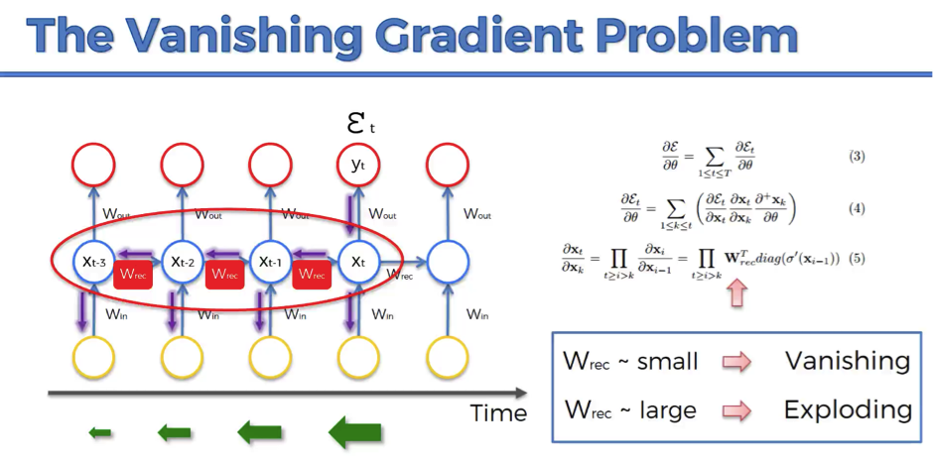
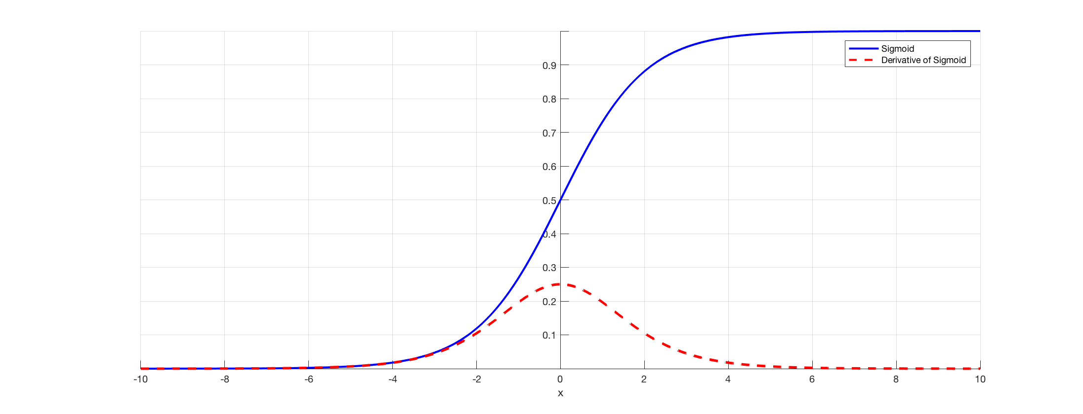

Slide 8
Solution to Vanishing Gradient Problem
Deep learning can be a good solution to the disadvantage. It does not rely on high-quality features, can learn the massive data and has strong generalization ability. LSTM, as an excellent variant of the RNN model, solves the problem of gradient disappearance in the process of gradient back propagation and is suitable for dealing with the problems of high correlation with time series.

Slide 9
LSTM(Long Short Term Memory) Neural Network
The LSTM Neural Network RNN is prone to Vanishing gradient or gradient explosion problems when learning long-term dependencies. As an improved version of RNN, LSTM can learn long-term dependency information and avoid the problem of Vanishing gradient .
In the neural nodes of RNN’s hidden layer, LSTM adds a structure called Memory cell to remember past information, and adds three gates (input, forget, and output) to control the use of historical information.

Slide 10
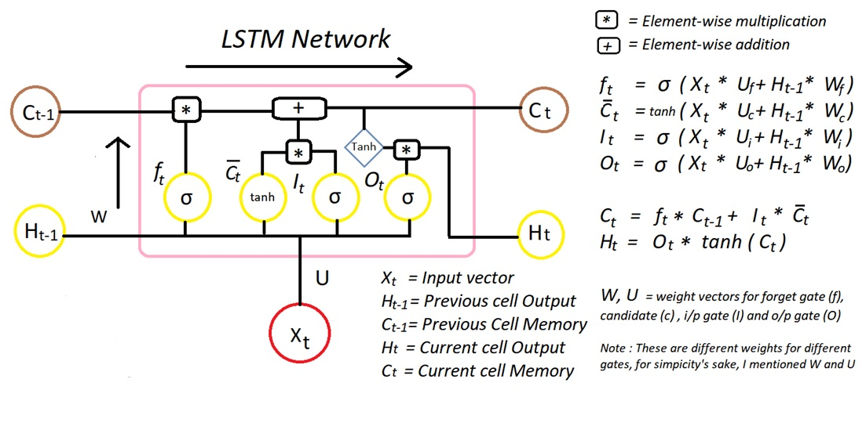
Fig. 1 Internal Structure of LSTM

Slide 11
Fig. 2 Structure diagram of LSTM

Slide 12
Model Used: FRS-LSTM Model
The prediction model is composed of two parts: fuzzy-rough set factor reduction (FRS) and neural network prediction (LSTM). The space dimension of input information is simplified by using FRS sensitivity to noise. Then take them as the input for the prediction part of the LSTM neural network. Properly compress the data variables, use LSTM to do the training and learning. The approximate implicit input-output nonlinear relation is extracted to obtain the wind speed prediction effect.

Slide 13

Sample Test Data

Slide 14
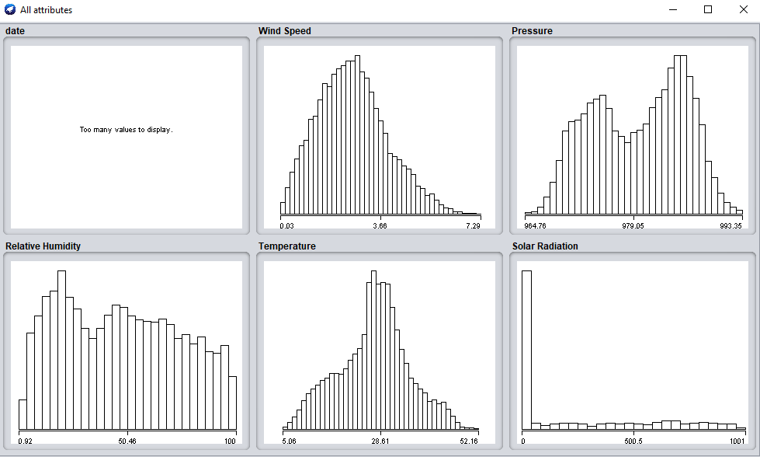
Impact of all Attributes on Wind speed
(Using Weka Tool)

Slide 15
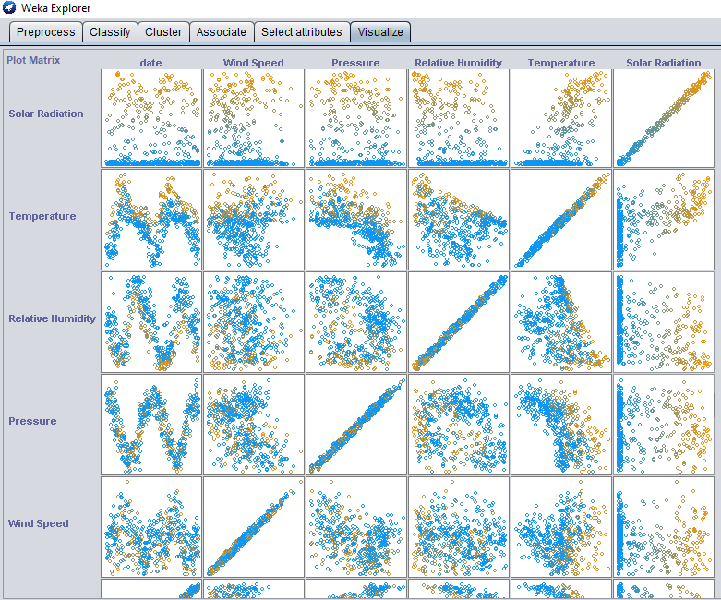
Visualization of data

Slide 16
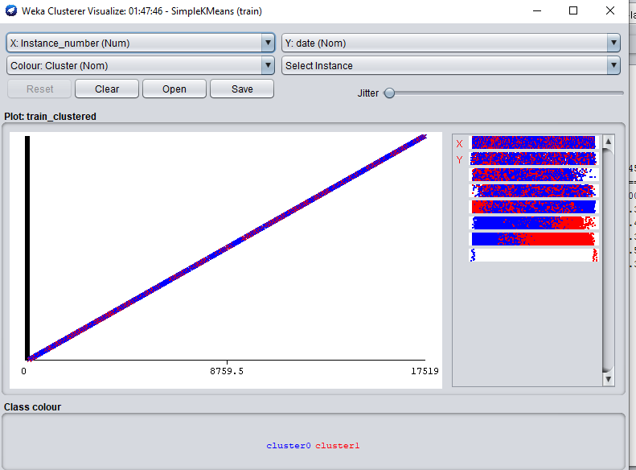
Cluster Formation (Using Simple K-Means)

Slide 17
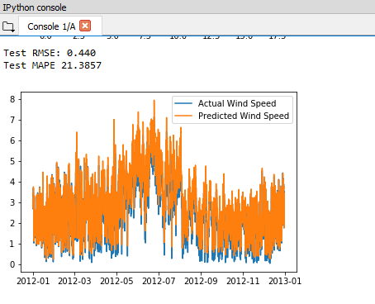
Resulted Prediction

Slide 18
Thank You!

